Slide 1
EcoSnap
The Smart App

Slide 2
What is EcoSnap?
You have a used product or package.
You use the app to scan the barcode.
You recycle the item.
By scanning the barcode, you will get EcoPoints.
You can spend those EcoPoints on rewards.
The more items you scan, the more experience you get, and the more levels you gain.
As your level gets higher, you will eventually be given a small discount which grows as you gain more levels.

Slide 3
What is our aim?
Encourage people to recycle more.
Give people a reason to want to recycle.
Reduce the amount of fuels burnt to create new materials which could be recycled instead.
Prevent littering.
So people are aware what can and can’t be recycled.

Slide 4
What can I recycle?
These are just some of the recyclable materials at the moment on the app.
You can recycle almost anything.
Material | Eco-Points | Experience
Aluminium | 15 | 10
Plastic Bottle | 14 | 9
Newspaper | 14 | 9

Slide 5
The Levels
Level 25
Reward Discount
Only pay 95%
5% Bonus per Material
Level 20
Level 10
2% Bonus per Material
Level 1
Level Up For More!
Reward Discount
Only pay 96%
4% Bonus per Material
Level 5
Level 15
Reward Discount
Only pay 97%
3% Bonus per Material
1% Bonus per Material

Slide 6
EcoPoints
Explained

Slide 7
EcoSnap
The App {Insert the app using a hyperlink}

Slide 8
FAQs
Questions
Answers
Q. How will we share the app and get it around to people?
Q. How will EcoSnap recognise products?
Q. What if they try to scan the same item many times?
Q. How will we fund it?
A. Using social media.
A. By scanning the barcode.
A. There will be a limit of scanning one item with the same item every twelve hours and for the items where you can get lots of points, it will be every twenty four hours instead.
A. We will need sponsors to provide eco-friendly rewards and some money. In return, their products will be advertised in the app.

Slide 9
FAQs Continued
Q. What are the rewards?
Q. Why choose EcoSnap?
A. Whatever the sponsors have provided at that time and also whatever your eco-points can buy you. This would be an eco-friendly item or something that would discourage burning fuels etc.
A. It encourages people to be eco-friendly by offering rewards in return for recycling objects and materials.

Slide 10
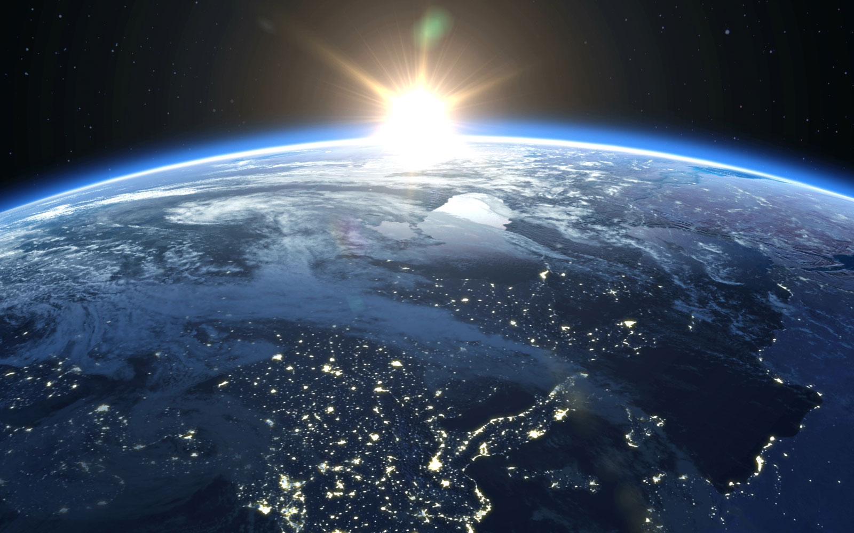
The Future
People are already creating ways to help us become more sustainable.
We won’t have any more fossil fuels to burn in 50-100 years time.
Cars won’t be powered by burning fuels.
It can be quite difficult to become sustainable in such a short period of time.
Sustainable sources are infinite so we will never run out of them.
What will Earth look like in the future?

Slide 11
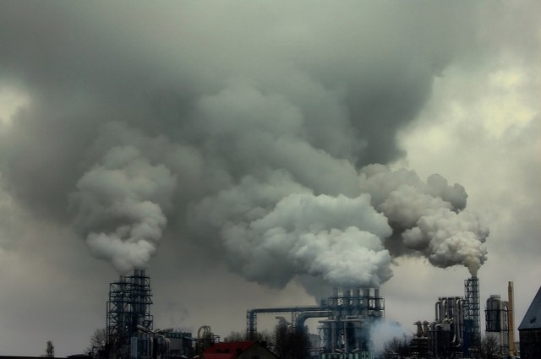
The Future
What it could look like…

Slide 12
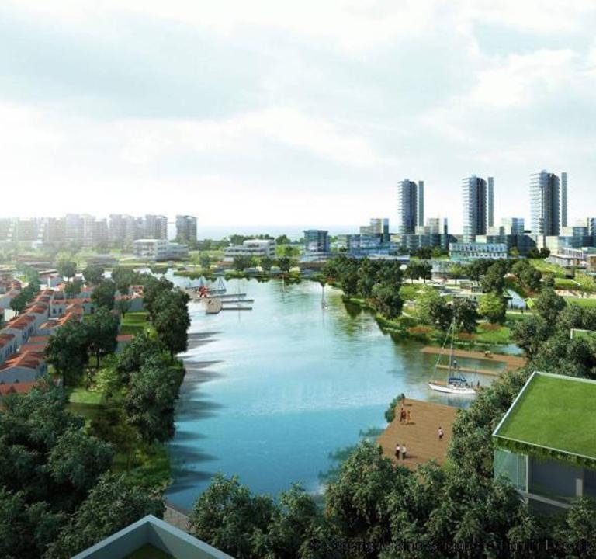
The Future
What it should look like…

